Slide 1


Consumer Goods Ad_Hoc Insights
Presented by Pruthviraj K For Atliq Hardwares

Slide 2
About Atliq Hardwares and Background
Atliq Hardwares is one of the leading computer hardware producers in India and expanded in other countries too.
Atliq Hardwares supplies electronic goods to the retailers (customers of Atliq Hardwares) like Croma,Best buy,Amazon,Flipkart, etc., who then sells the goods to the end consumers.
However, the management noticed that they do not get enough insights to make quick and data-informed business decisions.
There are 10 Ad-Hoc requests for which the company needs insights.
The approach is to run SQL queries to answer these 10 requests.
Convert the results into visualizations and present the insights to the top management.

Slide 3
Atliq's Product Line
PC
P&A
N&S
Desktop
Notebook
Peripherals
Accessories
Networking
Storage
1.Business desktop 2.Personal desktop
1.Gaming laptop 2.Personal laptop 3.Business laptop
1.Graphics card 2.Internal HDD 3.Mother board 4.Processors
1.Battery 2.Keyboard 3.Mouse
1.WiFi extender
1.External SSD 2.USB Flash drive

Slide 4
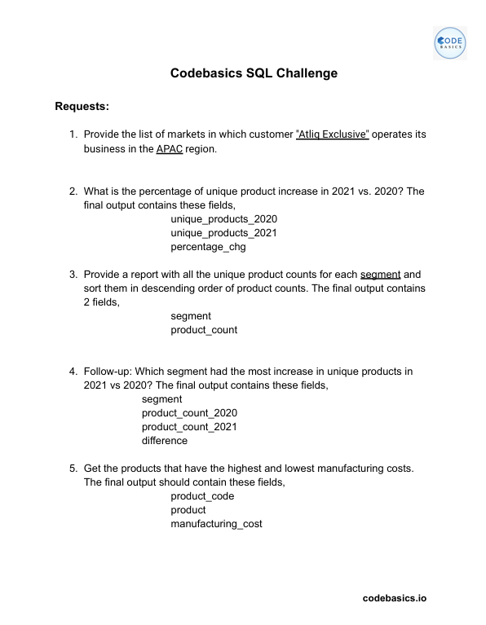
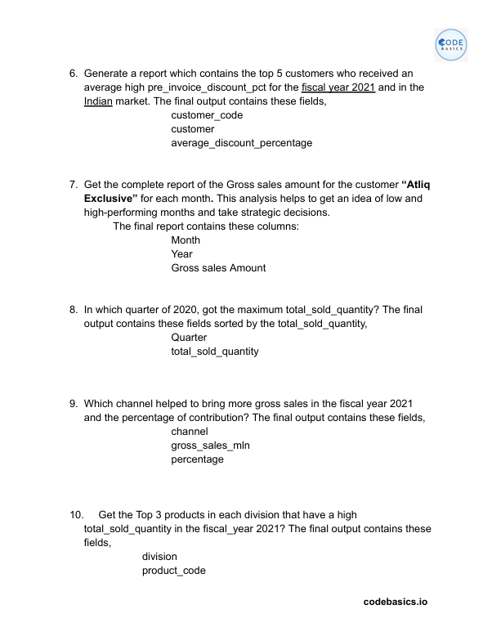
Ad-Hoc Requests

Slide 5
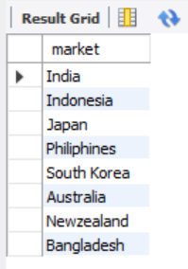

Request no.1: Provide the list of markets in which customer Atliq Exclusive operates it’s business in the APAC region.
Result
Query

Slide 6
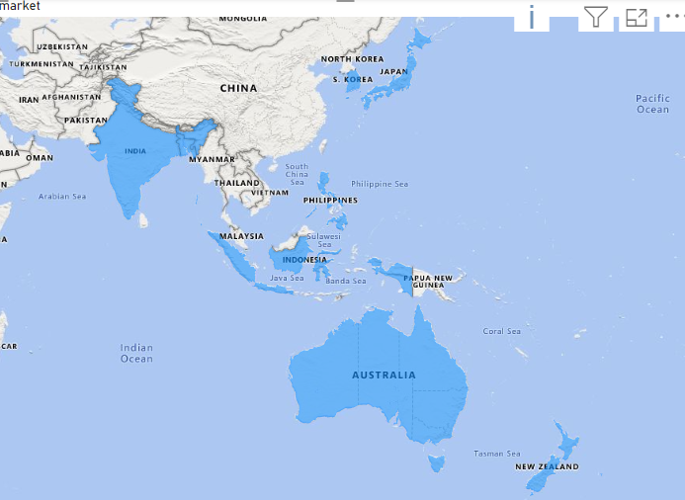
Insights
Atliq Exclusive has the most stores-8 in APAC region followed by 6 in EU and 2 in NA.

Slide 7
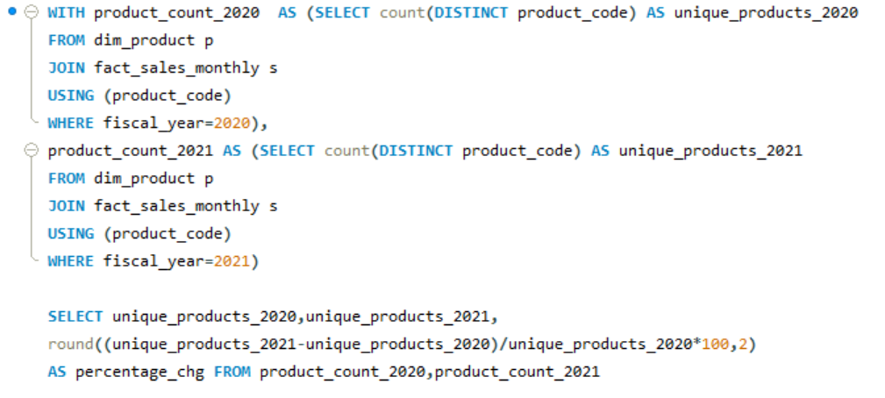

Request no.2: What is the percentage of unique product increase in 2021 vs. 2020? The final output contains these fields, unique_products_2020 unique_products_2021 percentage_chg
Query
Result
Atliq’s fiscal year starts from the September month of previous calender year

Slide 8
Insights
There is 36.33% increase in unique products from 2020-245 to 2021-334 .
Launching 89 new products in a year is a positive sign, signalling not only business growth but also pro active response to market demands and a commitment to innovation.

Slide 9
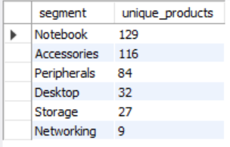
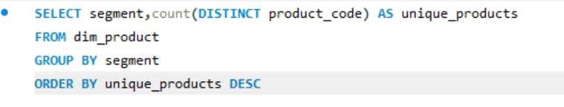
Request no.3: Provide a report with all the unique product counts for each segment and sort them in descending order of product counts. The final output contains 2 fields, segment and product_count.
Query
Result

Slide 10
Insights
Out of 6 segments, Notebook has the highest number of unique products (129) and networking has the lowest (9).
The Notebook, Accessories and peripherals segments dominates the product range comprising 82.87% of Atliq’s total product offerings.
Atliq ought to focus on expanding its product offerings in the Desktop, Storage and Networking segment to scale the business while also aligning with the current market trends and demands.

Slide 11
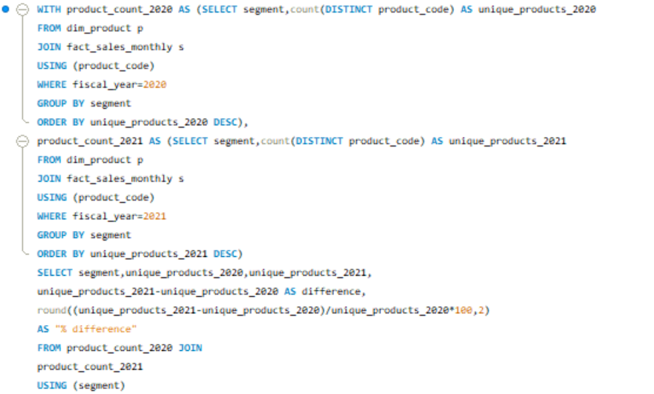
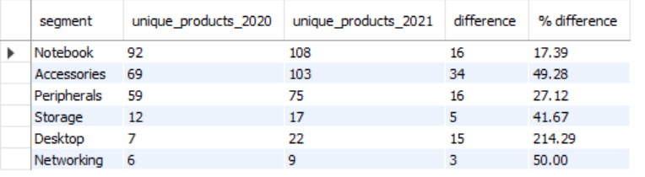
Request no.4: Which segment had the most increase in unique products in 2021 vs 2020? The final output contains these fields, segment, product_count_2020, product_count_2021, and difference.
Query
Result

Slide 12
Insights
Atliq had introduced 34 new products in accessories segment marking the largest product addition among other segments.
The Desktop segment saw the highest percentage difference with the addition of 15 new products which makes 214% increase compared to 7 products in 2020.
Networking and Storage have experienced the lowest production growth.

Slide 13
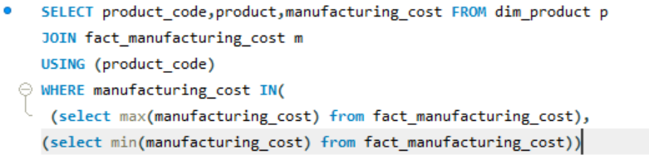
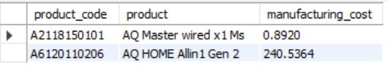
Request no.5: Get the products that have the highest and lowest manufacturing costs. The final output should contain these fields, product_code, product, manufacturing_cost
Query
Result
Insights
AQ Master wired x1 Ms has the lowest manufacturing cost of $ 0.89 where as AQ HOME Allin 1 Gen 2 has the highest manufacturing cost of $ 240.53.

Slide 14
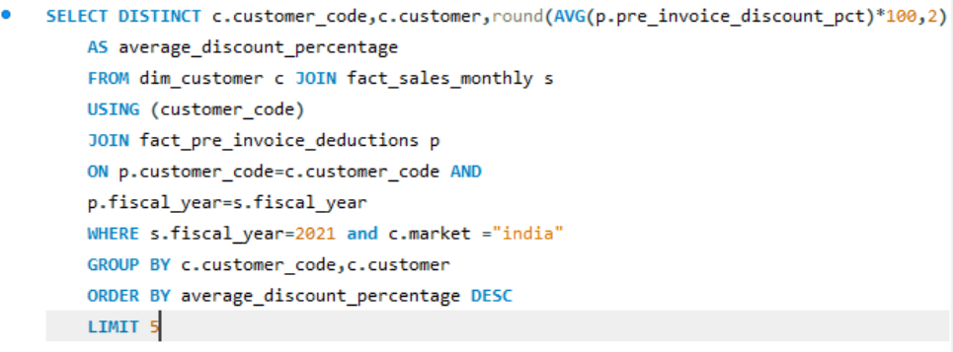
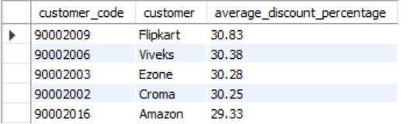
Request no.6: Generate a report which contains the top 5 customers who received an average high pre_invoice_discount_pct for the fiscal year 2021 and in the Indian market. The final output contains these fields, customer_code, customer, average_discount_percentage.
Query
Result

Slide 15
Insights
Flipkart received the highest average discount of 30.83% in fiscal year 2021 in India, marking it as the most discounted customer. Approximately equal average discount percentages were offered to each of our top 5 customers.

Slide 16
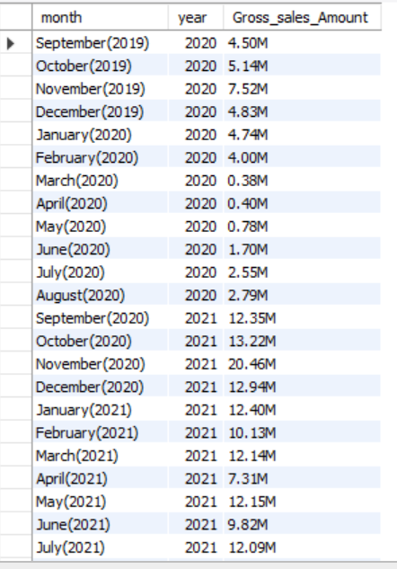
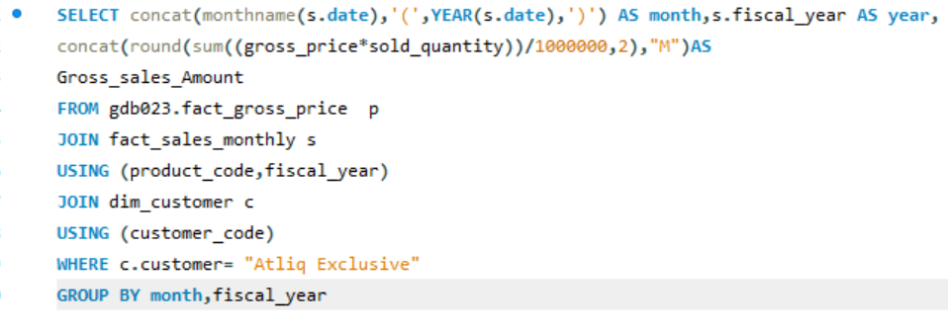
Request no.7: Get the complete report of the Gross sales amount for the customer “Atliq Exclusive” for each month . This analysis helps to get an idea of low and high-performing months and take strategic decisions. The final report contains these columns: Month, Year and Gross sales amount.
Result
Query

Slide 17
Insights
Atliq achieved its highest sales peak of $20.46 M in November 2020, a period coincides with festive season demand.
The lowest sales of $0.38 M were recorded in March 2020. The sharp decline from March to August was attributed to the impact of the coronavirus pandemic.
However, sales bounced back after the pandemic, showing resilience and surpassing the levels seen in 2020.
FY2020
FY2021
Atliq’s fiscal year starts from the September month of previous calender year

Slide 18
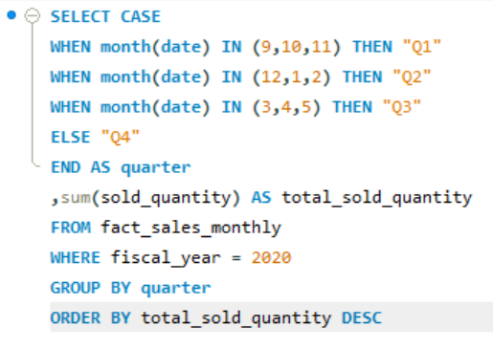
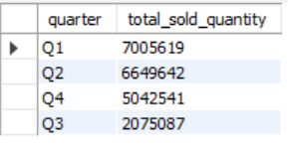
Request no.8: In which quarter of 2020, got the maximum total_sold_quantity? The final output contains these fields sorted by the total_sold_quantity, Quarter, total_sold_quantity
Query
Result

Slide 19
Insights
FY2020 experienced its highest quantity sold during Q1 (September to December 2019), demonstrating strong performance driven by the festive season in India.
Sales experienced a downturn in Q3 (March to May 2020), attributed to the effects of the pandemic.
In Q4, there was a notable uptick in sales, signaling a promising trend of recovery.

Slide 20
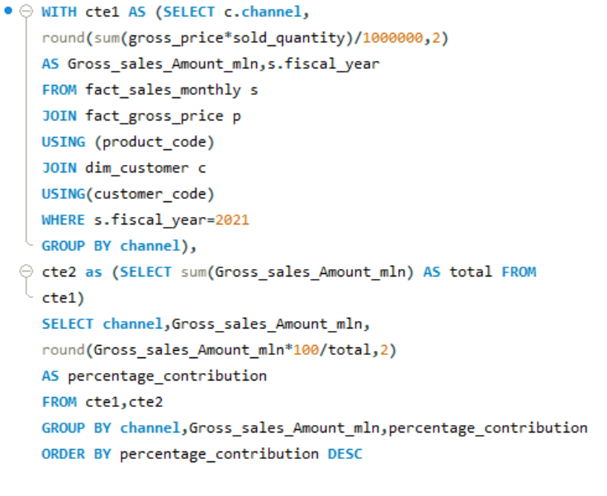
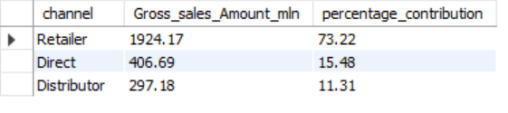
Request no.9: Which channel helped to bring more gross sales in the fiscal year 2021 and the percentage of contribution? The final output contains these fields, channel, gross_sales_mln, percentage.
Query
Result

Slide 21
Insights
Retailers significantly contributed, bringing in $1924.17 million to the revenue, accounting for 73.22% of total sales in FY 2021.
Sales through direct and distributor channels represent a smaller portion of the company's total revenue.

Slide 22
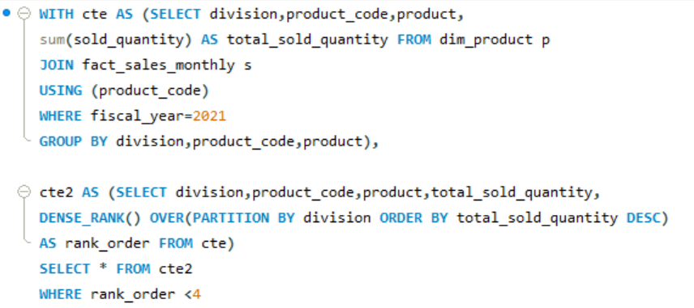
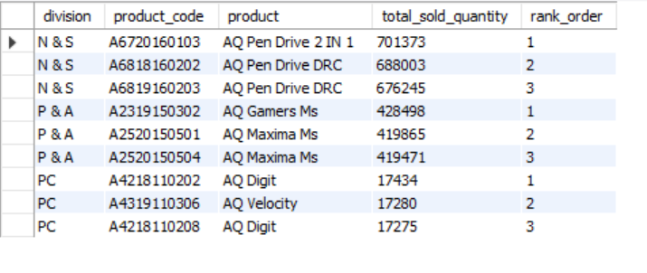
Request no.10: Get the Top 3 products in each division that have a high total_sold_quantity in the fiscal_year 2021? The final output contains these fields, division, product_code, product, total_sold_quantity, rank_order.
Query
Result

Slide 23
Insights
AQ Pendrives are the top 3 most selling products from the N & S division.
In P & A division, AQ Gamers Ms and AQ Maxima Ms (Pen Mices) were the leading products.
Within the PC division, AQ Digit and AQ Velocity (Laptops) are the most selling products.

Slide 24
Thank you

